Slide 1

(DR. BABASAHEB AMBEDKAR TECHNOLOGICAL UNIVERSITY, LONERE) RAJIV GANDHI COLLEGE OF ENGINEERING, RESEARCH TECHNOLOGY, CHANDRAPUR Department of Computer Science and Engineering (2024-25)
MINI PROJECT -II Progressive Seminar
On
“STUDY NEST”
SEMESTER- VI THIRD YEAR
Submitted By GROUP 7:
Guided by Dr.Nitin Janwe Project Incharge
Dr.Madhavi Sadu HOD,CSE Prof.Madhavi Sadu
Deepak Dey CSEA641
Samiksha Sorte CSEA643
Dhanashree Nikhate CSEA647
Urvashi Waghmare CSEA644
Adyashri Shinde CSEA672

Slide 2


STUDY NEST
“ONLINE LEARNING PLATFORM WITH AI RECOMMENDATION SYSTEM “

Slide 3


Overview
Introduction
Problem statement with objectives
Algorithm
& Methods
Modules
Output
Conclusion
Reference

Slide 4
Introduction
StudyNest is a user-friendly learning platform designed to help students succeed in their academic journey.
It provides role-based access for Students and Tutors, semester-wise modules, and interactive MCQ tests with instant results.
The platform generates personalized certificates and offers an AI-powered course recommendation system to guide students towards the right learning paths.

Slide 5

Problem Statement
Lack of semester-wise study resources at one place
No instant quiz feedback for students
Manual certificate generation is slow
No personalized course recommendations
Tutors struggle to monitor student progress

Slide 6


Objectives
Provide semester-wise learning modules
Enable instant MCQ test evaluation
Auto-generate digital certificates
Recommend courses using AI
Ensure secure login & data handling
Offer student report.

Slide 7
Algorithms & Methods Used
Role-Based Authentication: Secure login system using Spring Security + BCrypt password encryption.
MCQ Test Evaluation: Real-time comparison of student answers with correct options to calculate score instantly.
Certificate Generation: iText PDF library used to auto-generate digital certificates with student details.
AI Course Recommendation: Basic rule-based AI chatbot by using the “API.COHERE.AI”.
Data Handling: MySQL + JPA for reliable data storage and retrieval of users, tests, results, and recommendations.
Secure Session Management: Spring Boot session handling + validation for safe data access.

Slide 8
Modules
User Registration
Redirect to users semester dashboard
Consuming the content of all the modules
MCQ based test of each module
Check progress & Certificate generation
Ai recommendation for low grades
Student report generation by admin

Slide 9
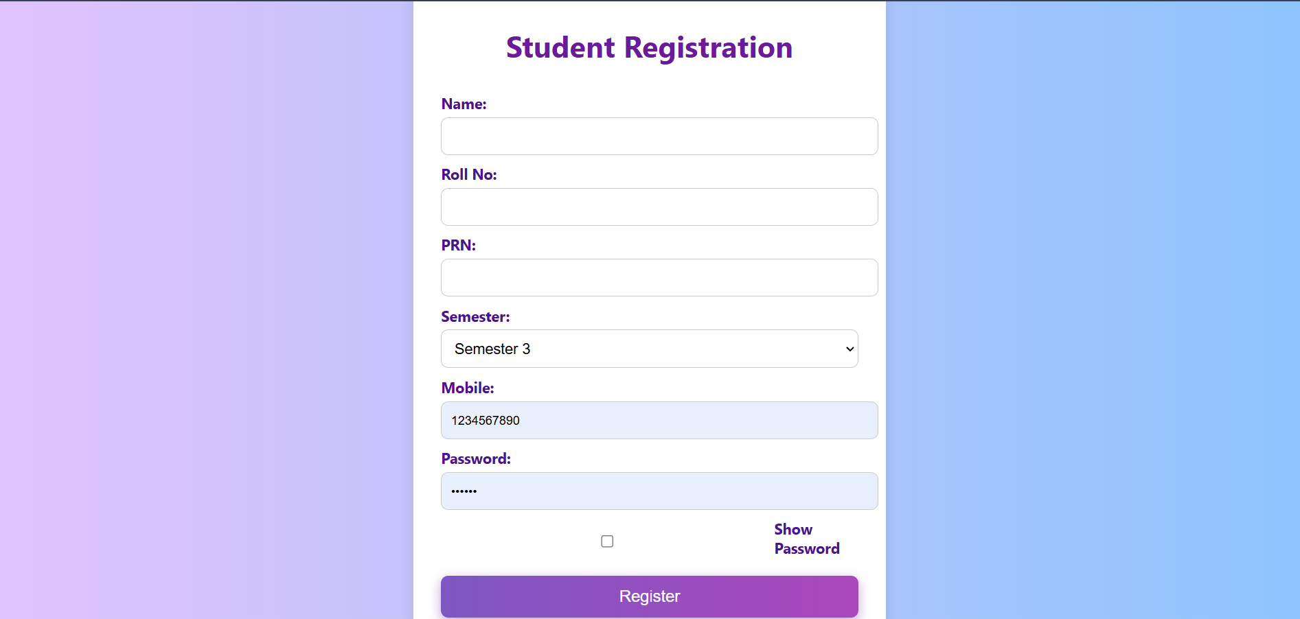
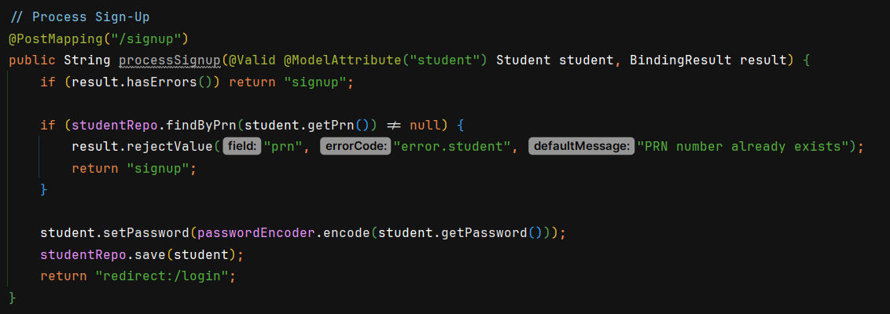
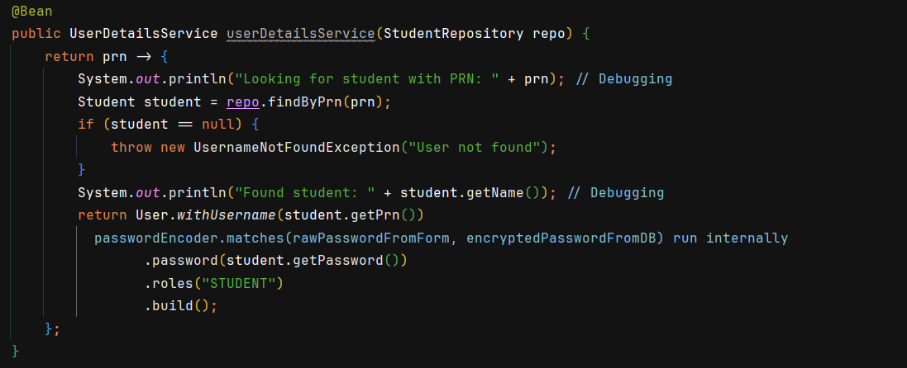
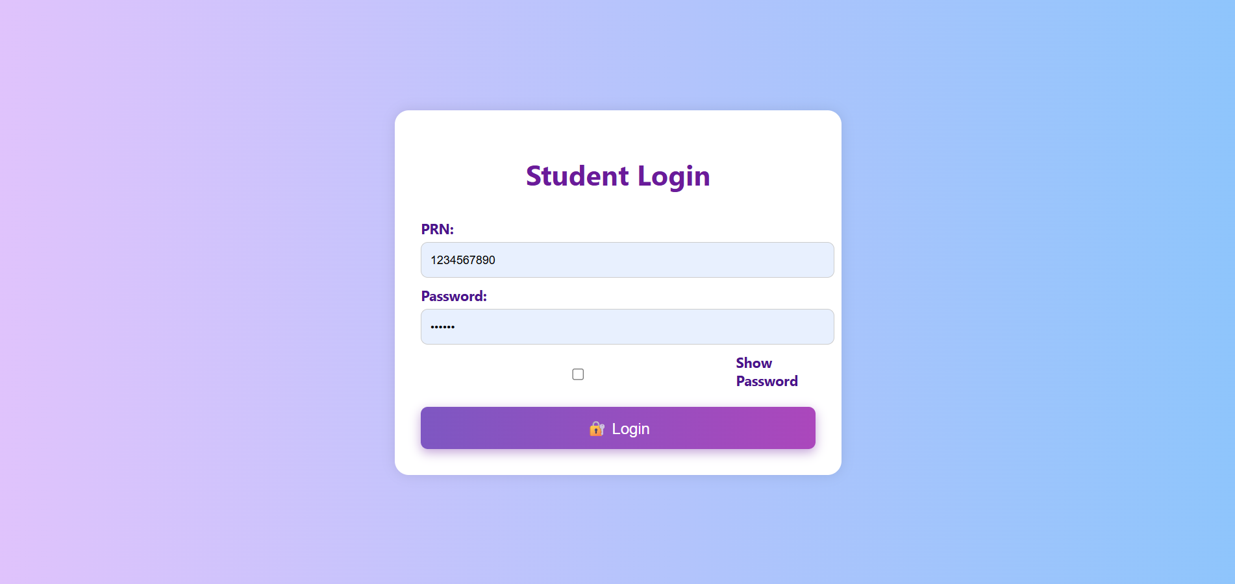
Output
Modules 01: User Registration

Slide 10
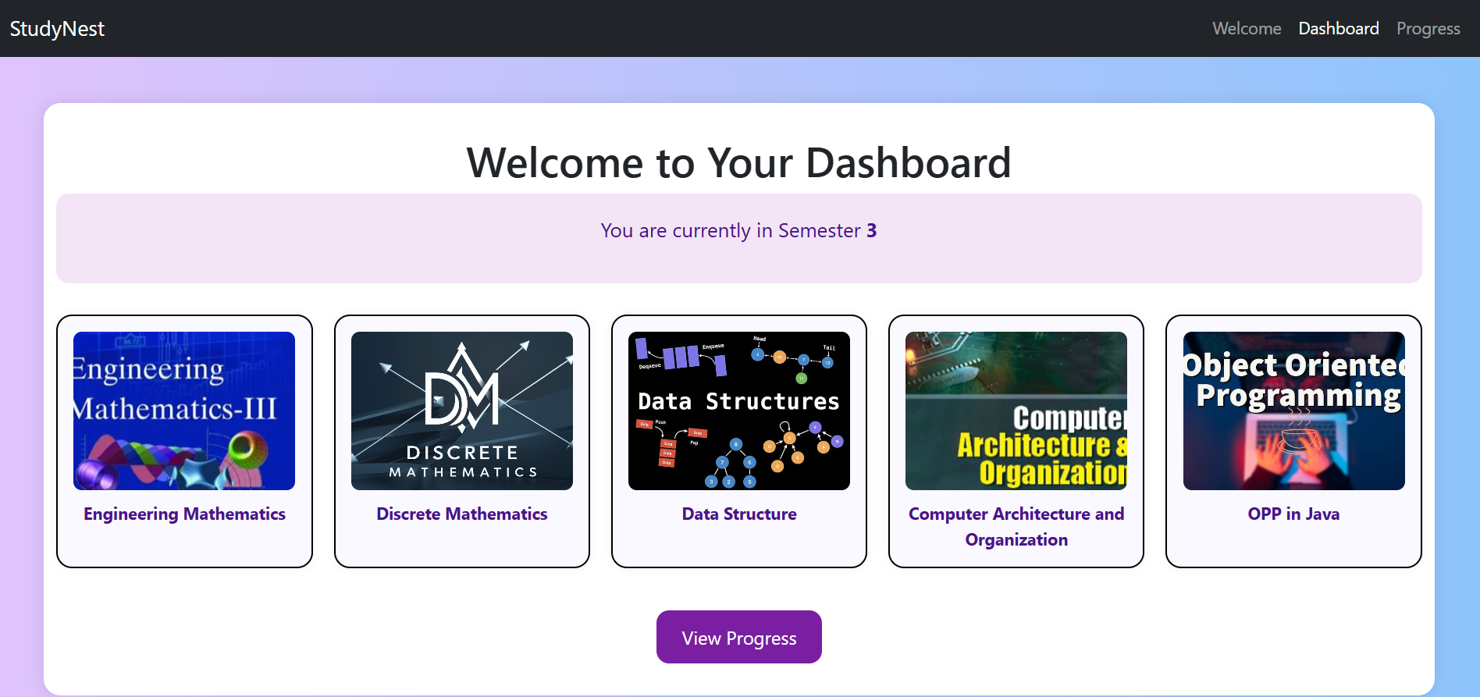
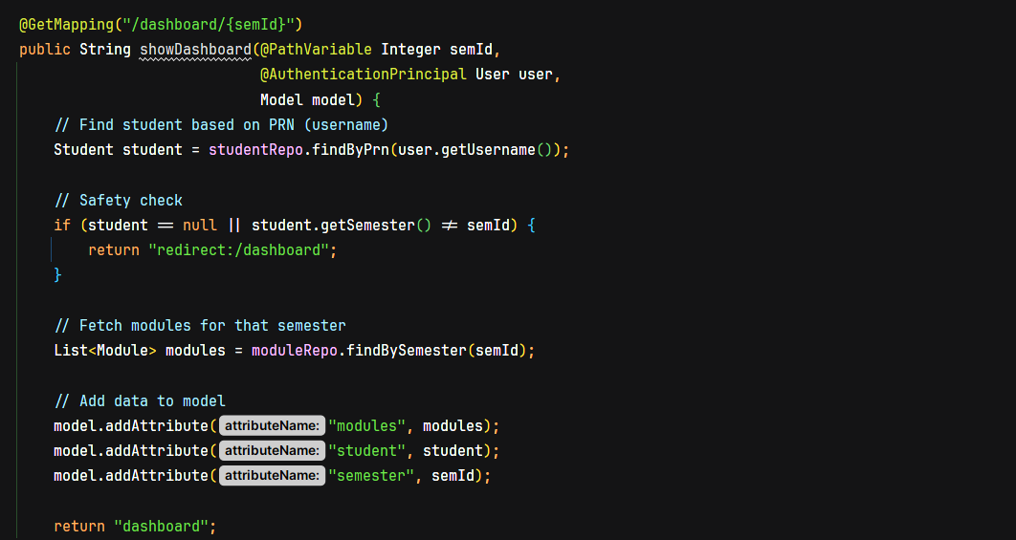
Output
Modules 02:Redirect to users semester dashboard

Slide 11

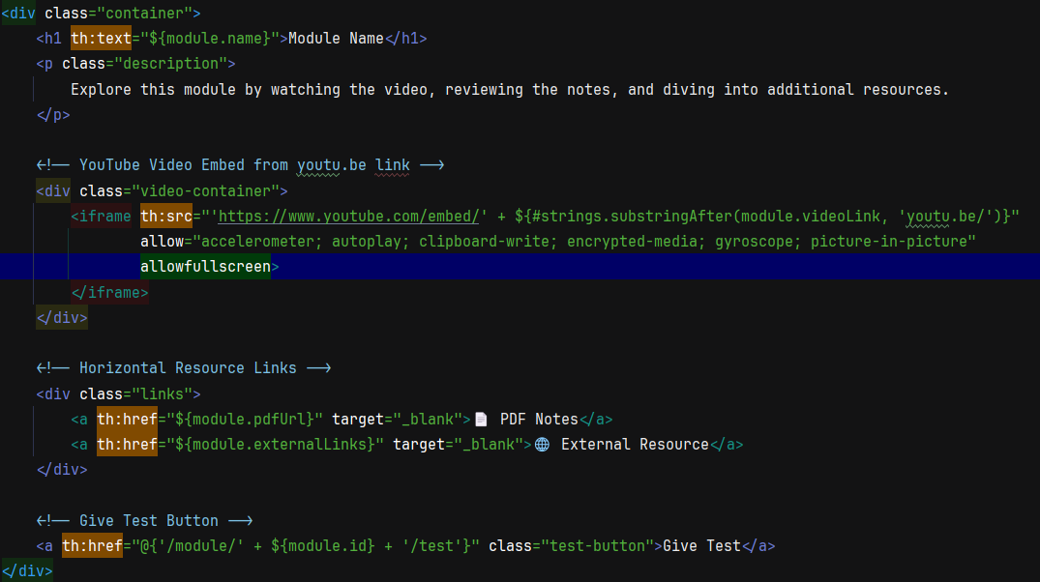
Output
Modules 03:Consuming the content of all the modules

Slide 12
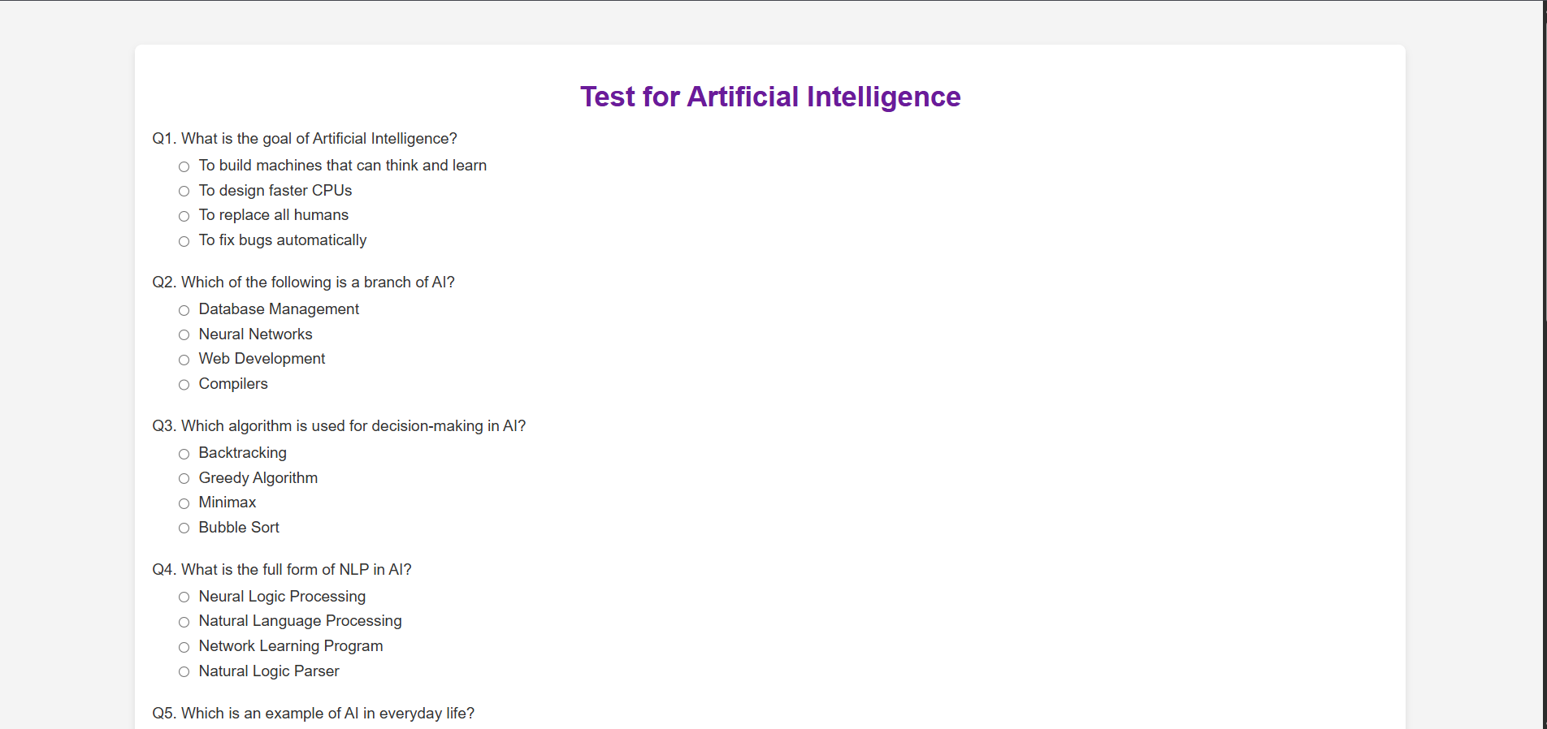
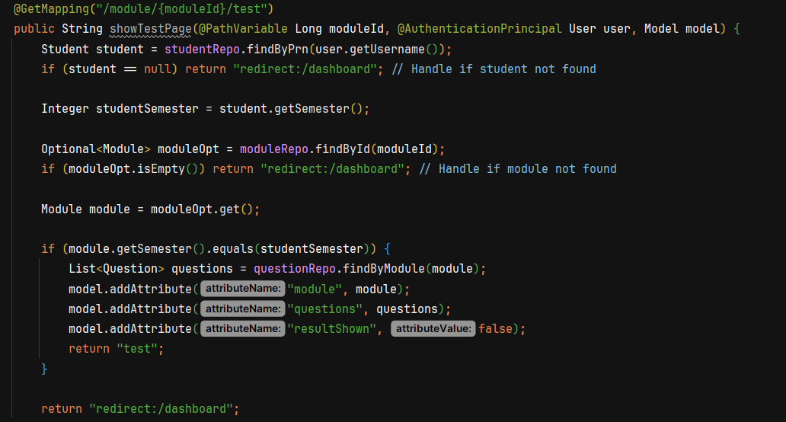
Output
Modules 04:MCQ based test of each module

Slide 13
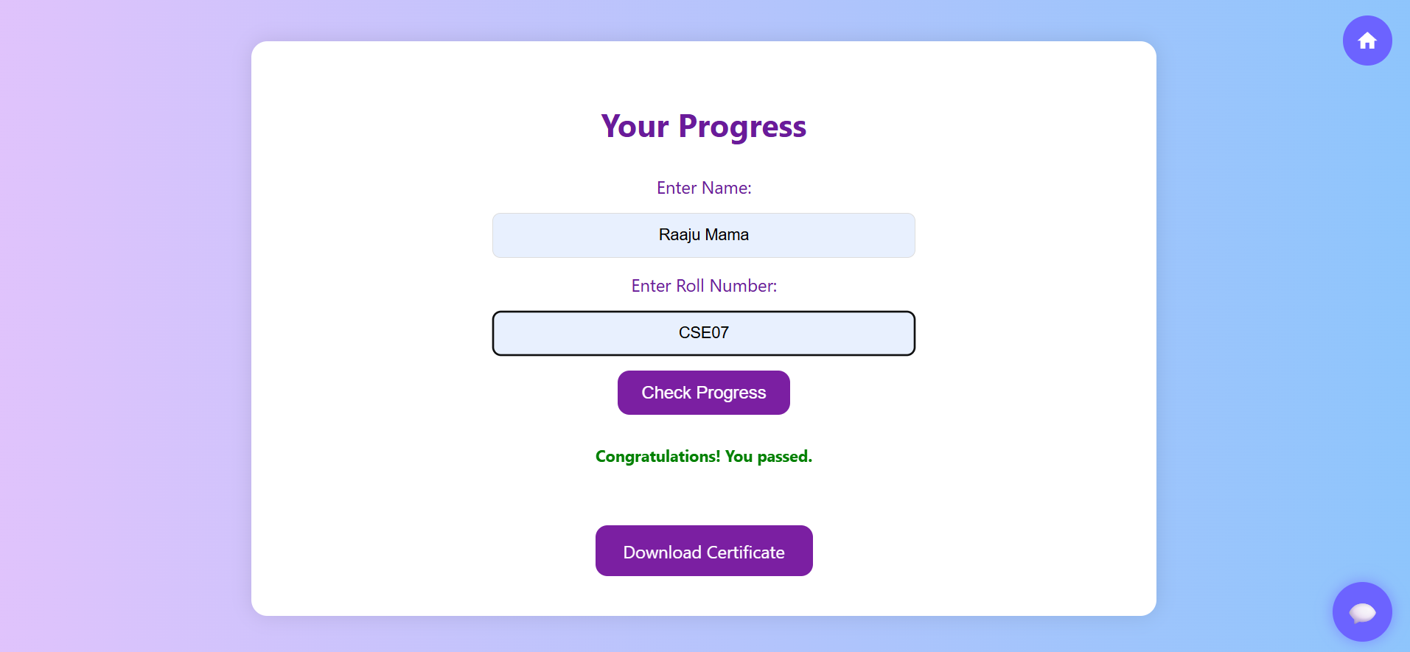
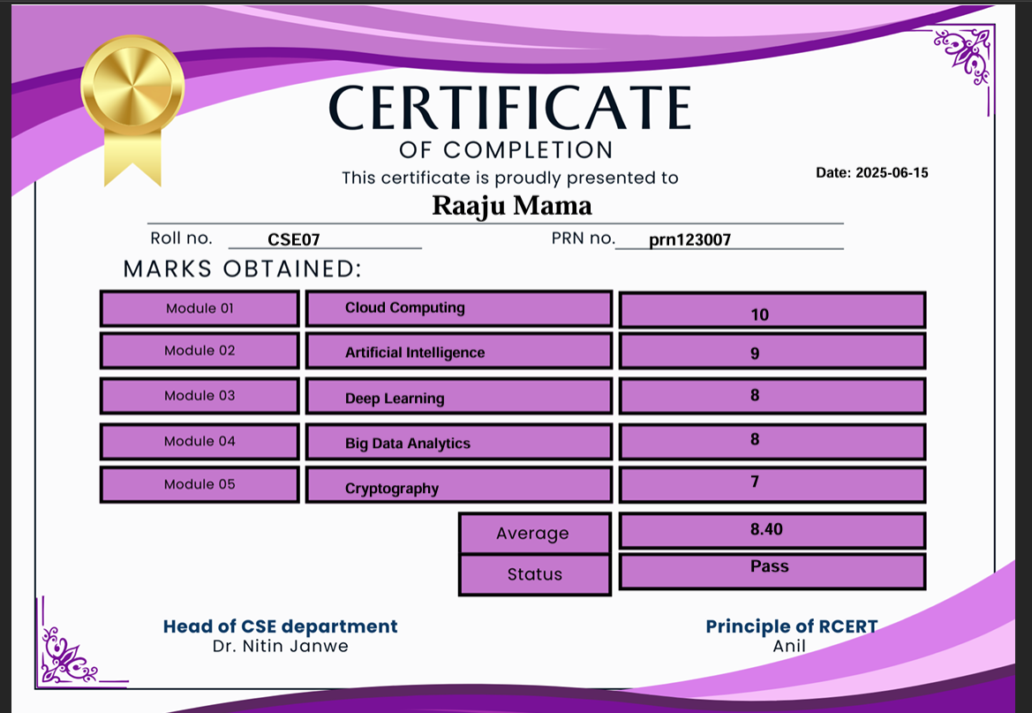
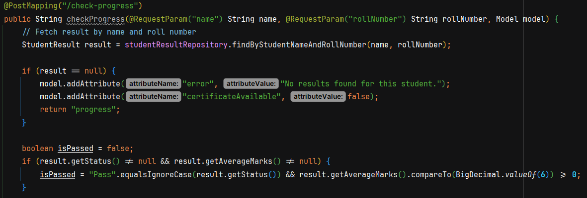
Output
Modules 05:Check progress & Certificate generation

Slide 14
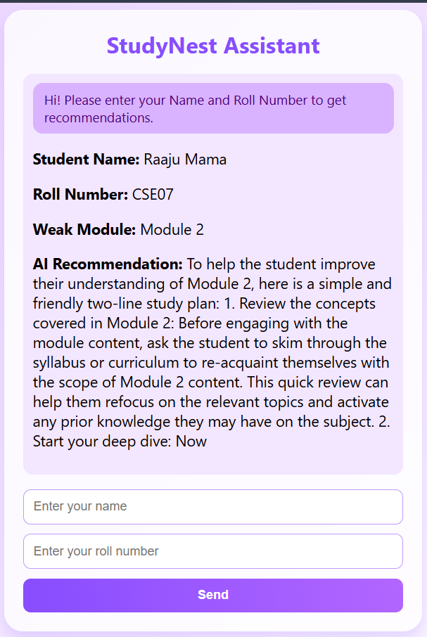
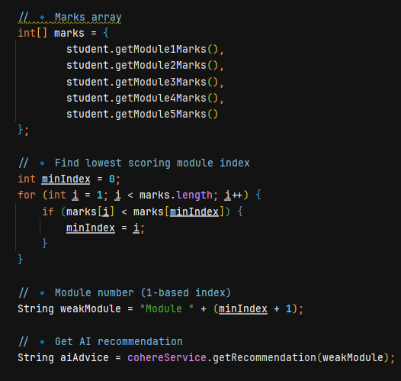
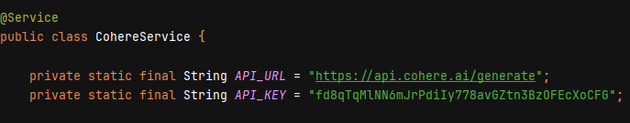
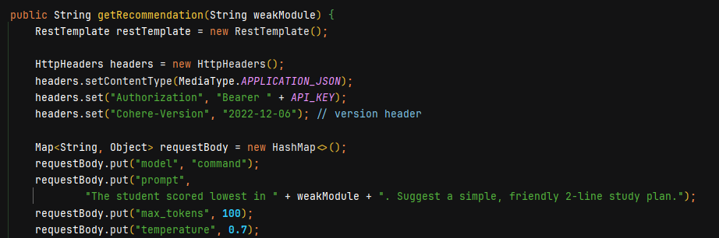
Output
Modules 06: Ai recommendation for low grades
API

Slide 15
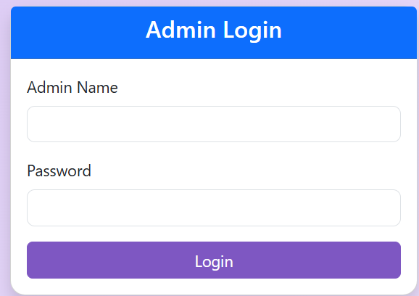
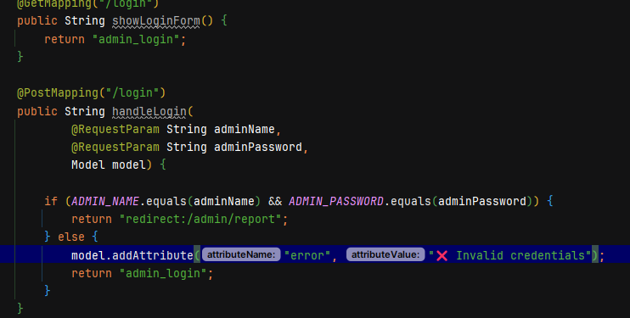
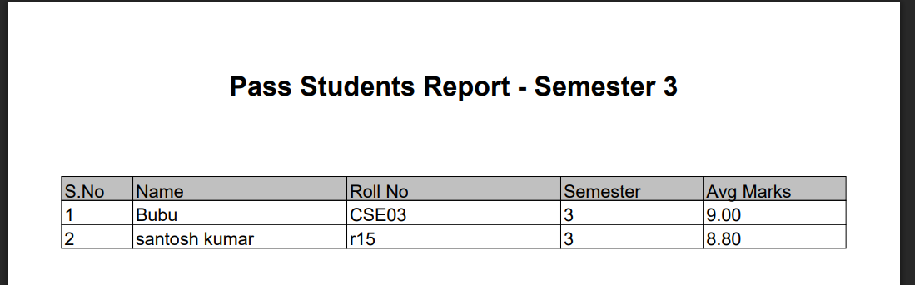
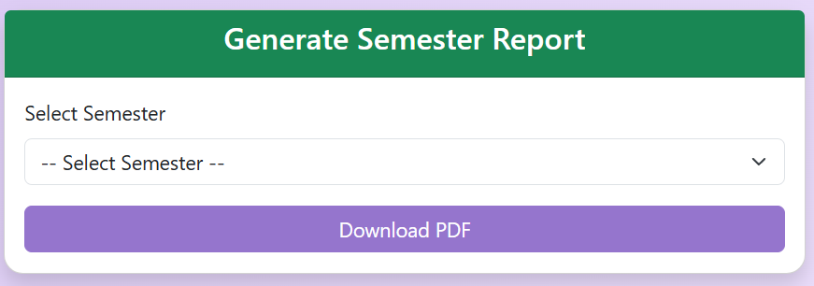
Output
Modules 07: Student report generation by admin
Bishal Roy

Slide 16
Conclusion
StudyNest is more than just a learning platform — it is a complete academic companion designed to simplify, guide, and empower students. From structured semester-wise modules to instant quiz evaluations and auto-generated certificates, it ensures every student’s effort is recognized and rewarded.
With the power of AI recommendations, StudyNest helps students discover the right courses that match their goals and abilities.
Our aim is to create a smarter, secure, and personalized learning experience that supports both students and tutors on the path to success. StudyNest — where learning meets innovation.
Aaron Loeb
Alfredo Torres
Juliana Silva
Daniel Gallego
Olivia Wilson
Project manager
CEO & Founder
IT Expert
Marketing Head

Slide 17

Reference
ChatGPT – Conversational AI by OpenAI
OpenAI – AI research organization behind ChatGPT
Spring Boot – Backend framework for Java applications
GitHub – Code hosting & collaboration platform
Udemy – Online course marketplace
Youtube – For getting references of other projects

Slide 18

THANK YOU!

